Slide 1
L4/5 Group 4
Ripple Footie
Connor Wilby
Sam Clack
Henry Smith
Heather Bishop

Slide 2
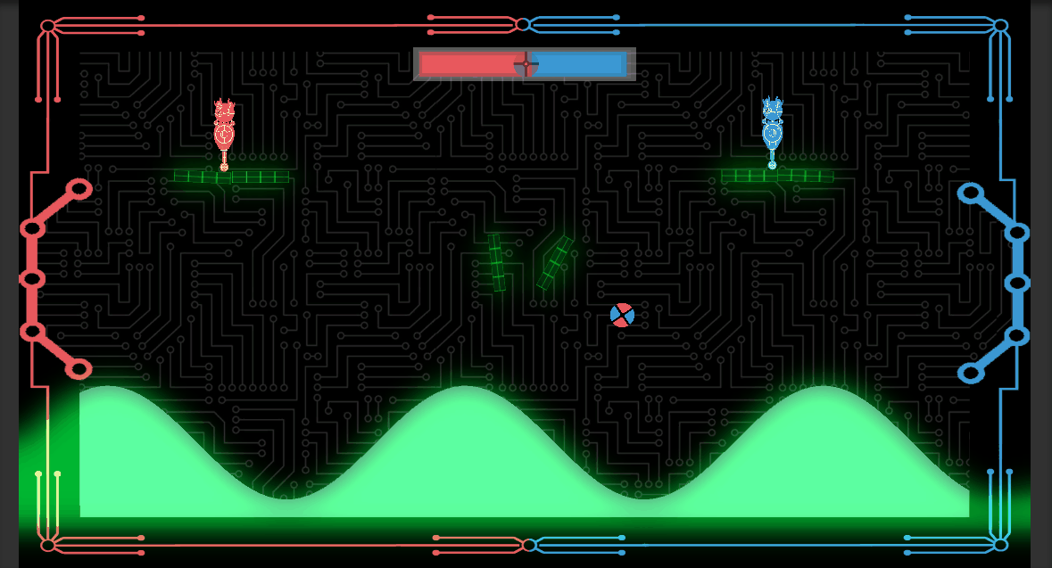
Where We Finished Last Time…
Adding polish to existing mechanics and experience.

Slide 3
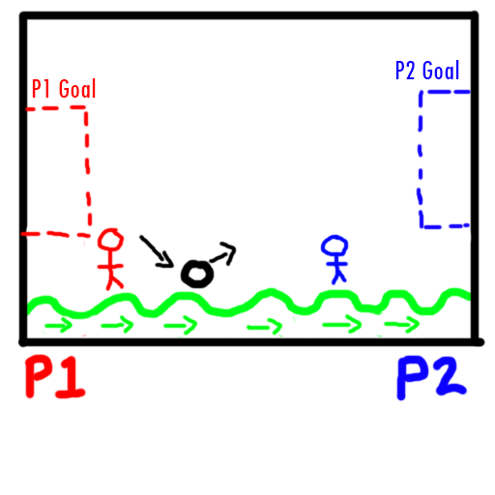
Expected Delivery Standard
Objective: Two players must get a single ball into the opponents goal.
Symmetrical simultaneous gameplay.
Fully operational UI/Visual Feedback.
Fine tuned wave (e.g. when to start, how fast, who receives the starting advantage).
Completed art assets.

Slide 4
How Does It Meet The Brief?
2D environment
Physics generated by the terrain mimicking a wave, as well as the ball itself
Gameplay is symmetric/simultaneous.
Adversarial: one user attempting to score enough goals to win
Both players use a keyboard to control their character
Our game is original because it takes a tried and tested formula for multiplayer and puts a different spin on it by making the terrain the true adversary.

Slide 5
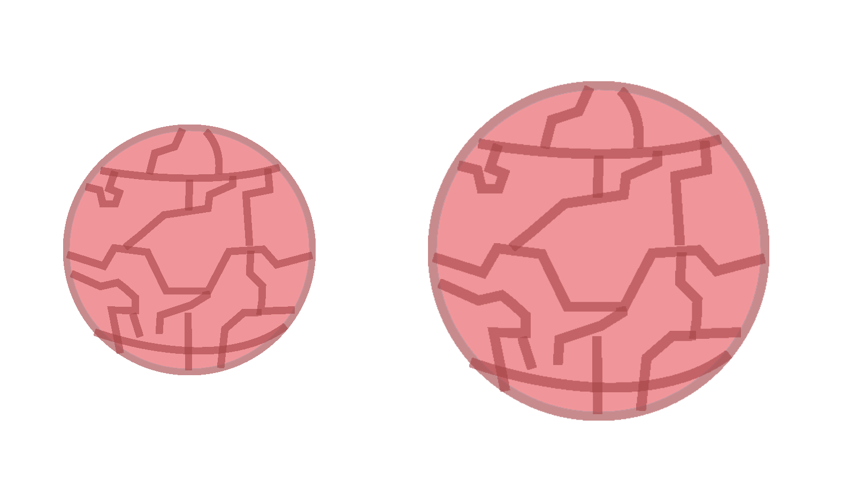
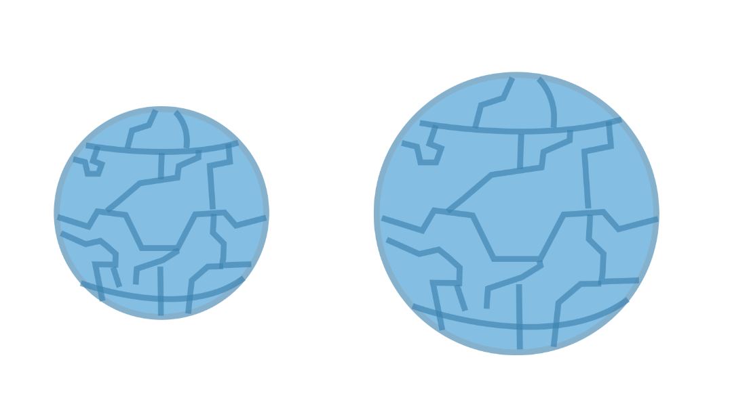
Currently implemented:
Main Menu
Character movement
Wave
Scoring goals (and win condition)
End screens

Slide 6
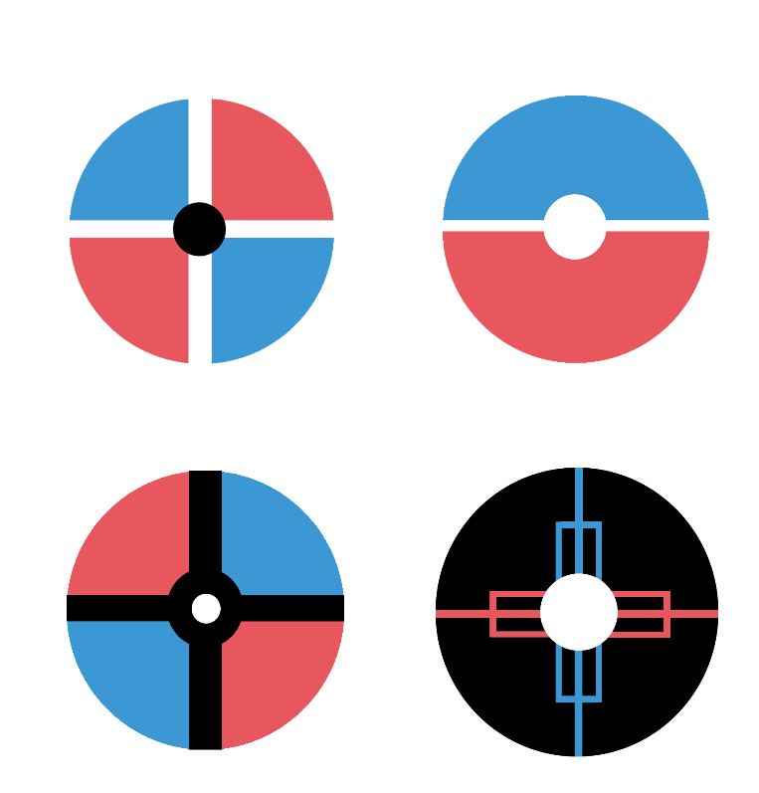

Balancing Skill vs Chance
Skill is in the precision of judging the most opportune moment to hit the ball directly or when to bounce it off the wave.
The chance comes from how the wave alters the angle in which the ball bounces.
The use of six platforms with a hinge joint in the centre create more dynamic gameplay and influence the ball.

Slide 7
Playtesting
Playtesting results…
8 people play tested in total.

Slide 8
Playtesting
Observations
Players were not bored
Players were laughing, mocking each other and competing against each other in a friendly way.
There weren’t players winning/scoring more consistently than the other
No players gave up before the game was over.
If a player is more experienced at the game, then skill can overcome chance. This may need to be balanced in future.

Slide 9


Aesthetics
Background is a solid colour with subtle detailing to adhere to squint test and prevent screen from being too busy.

Slide 10
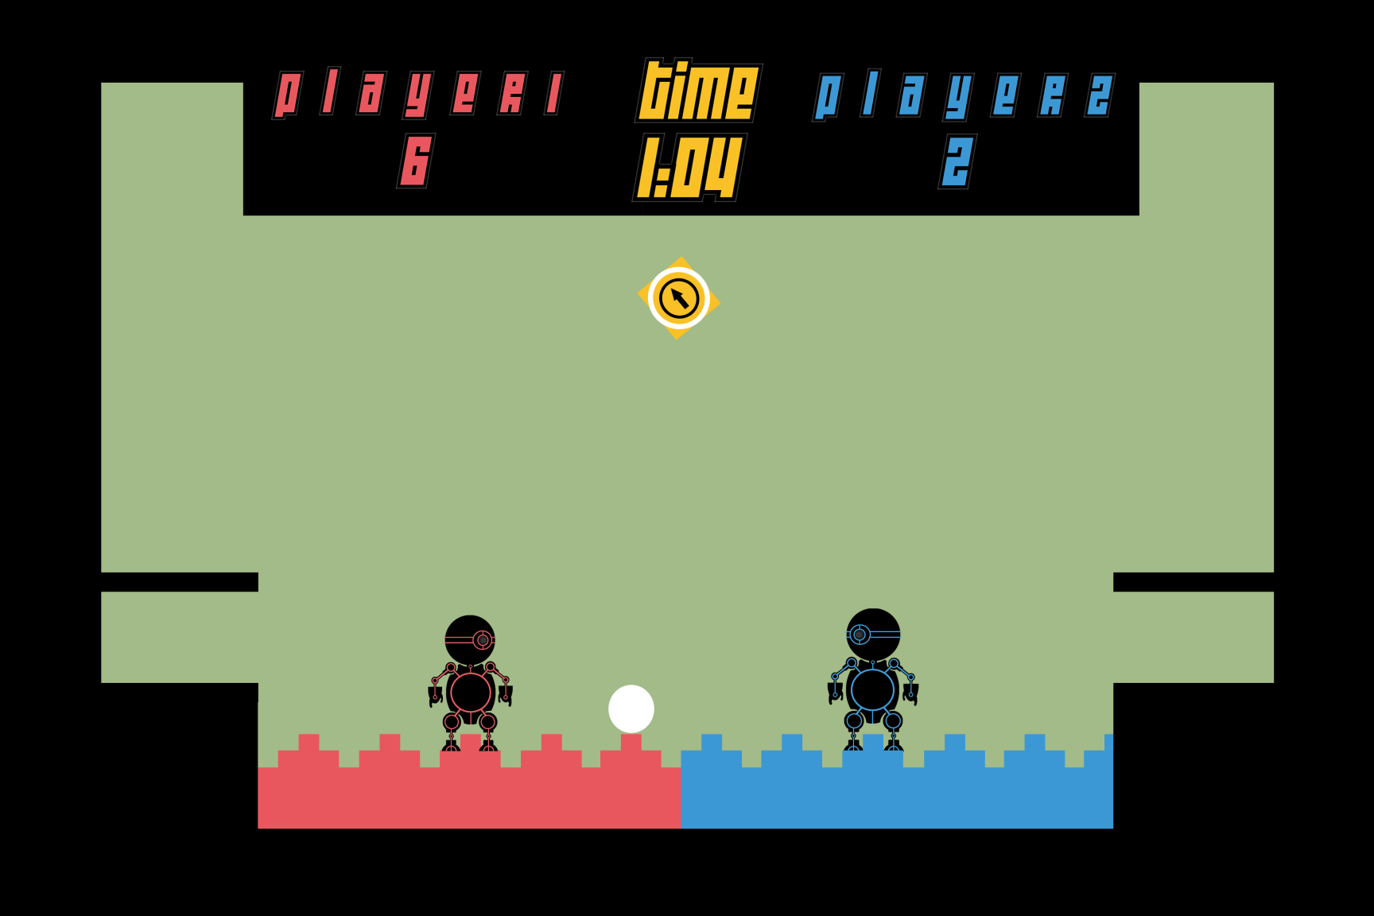
Aesthetics
Foreground has been iterated many, many times.

Slide 11
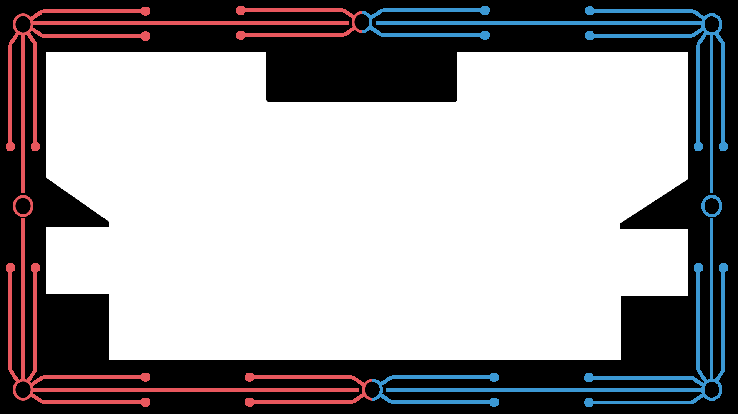
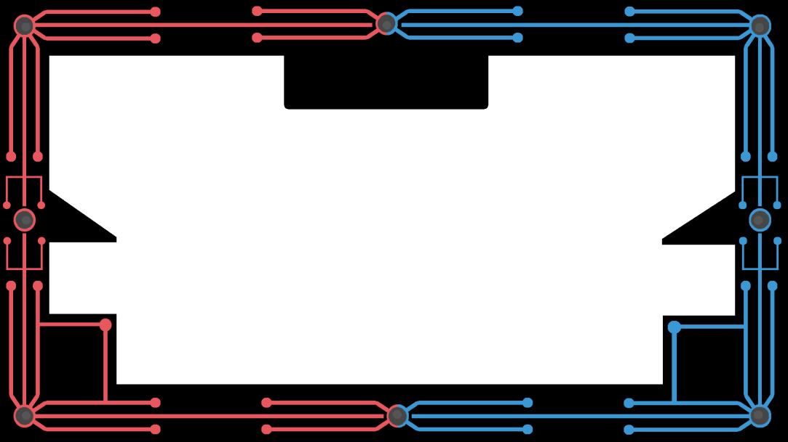
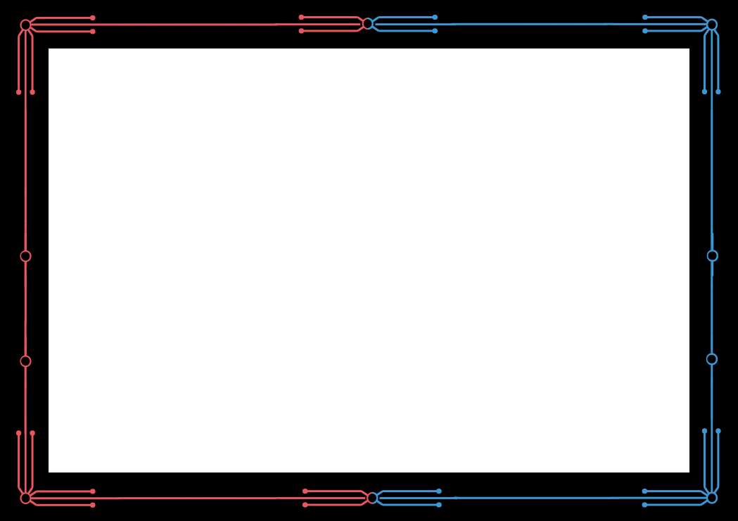
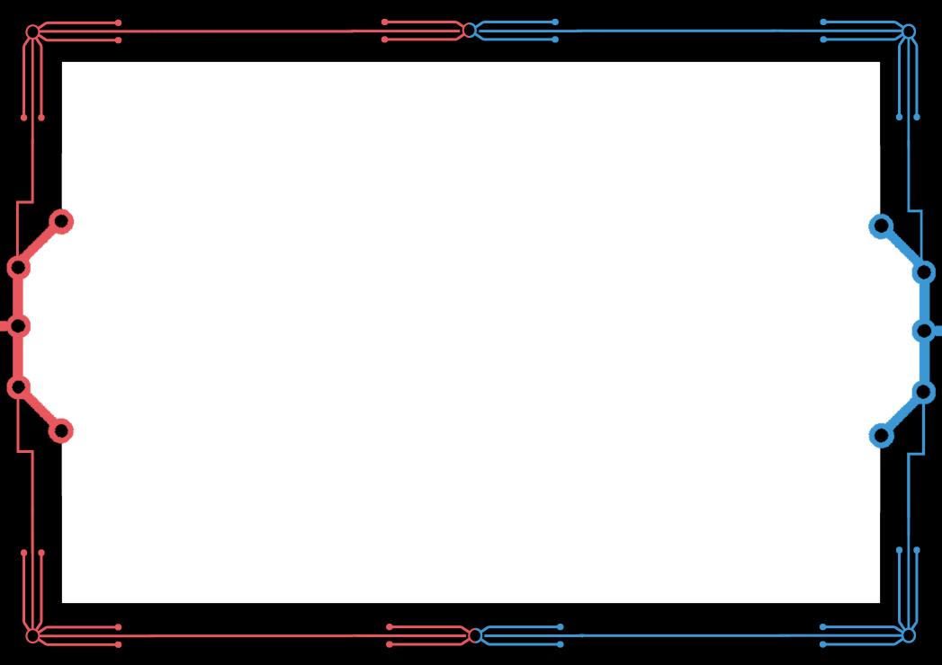
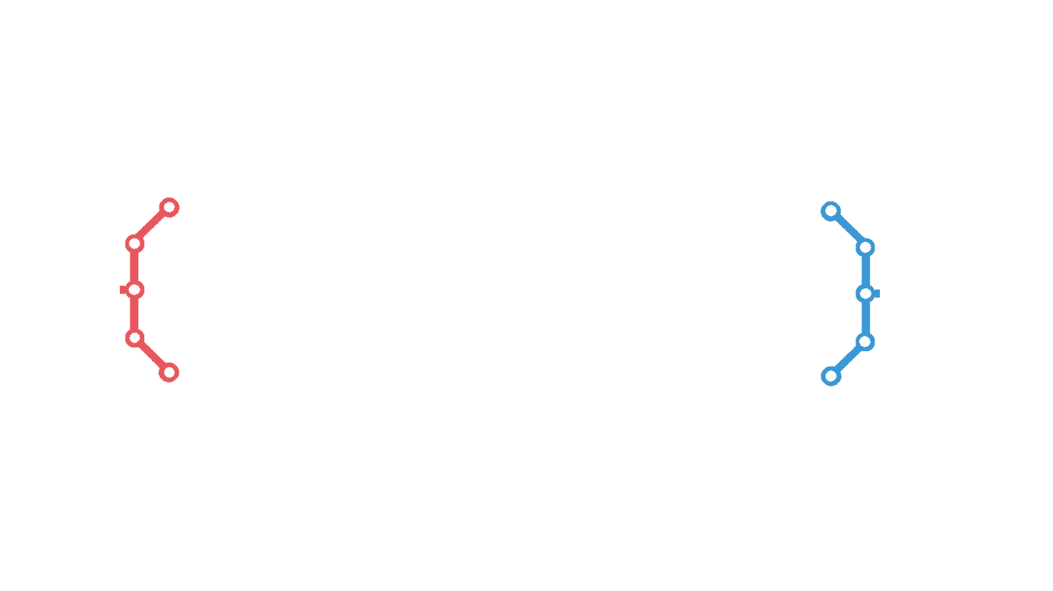
Foreground

Slide 12
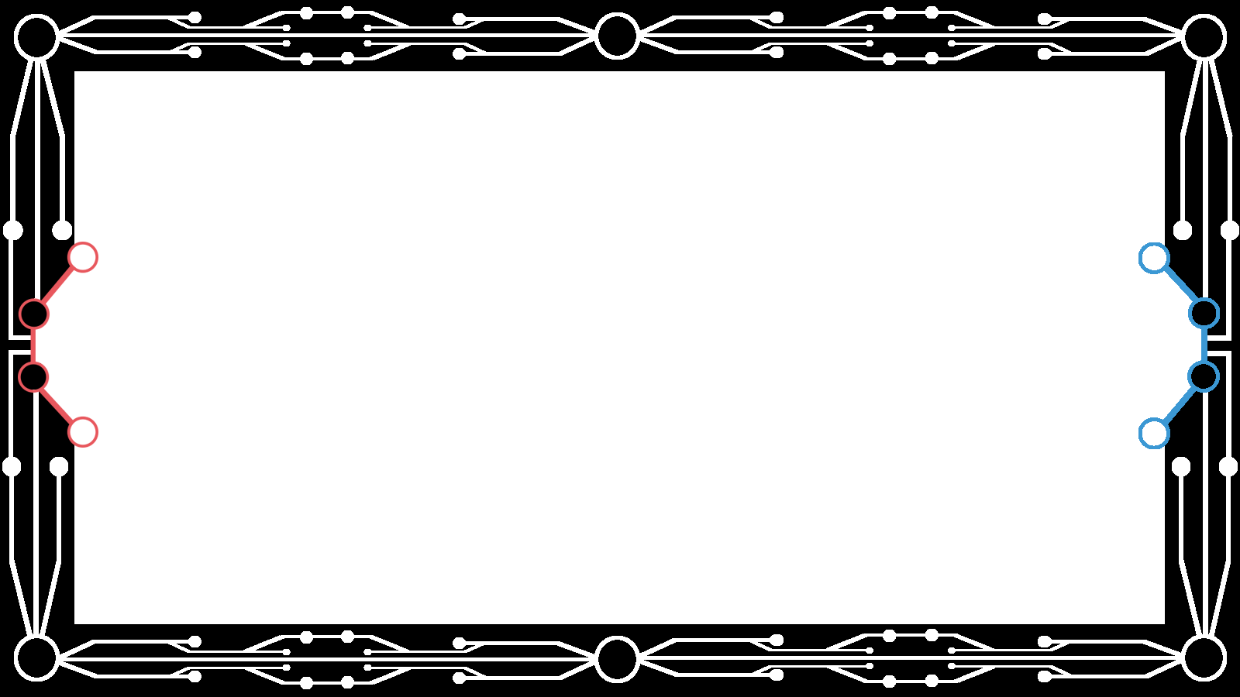
Current Iteration

Slide 13
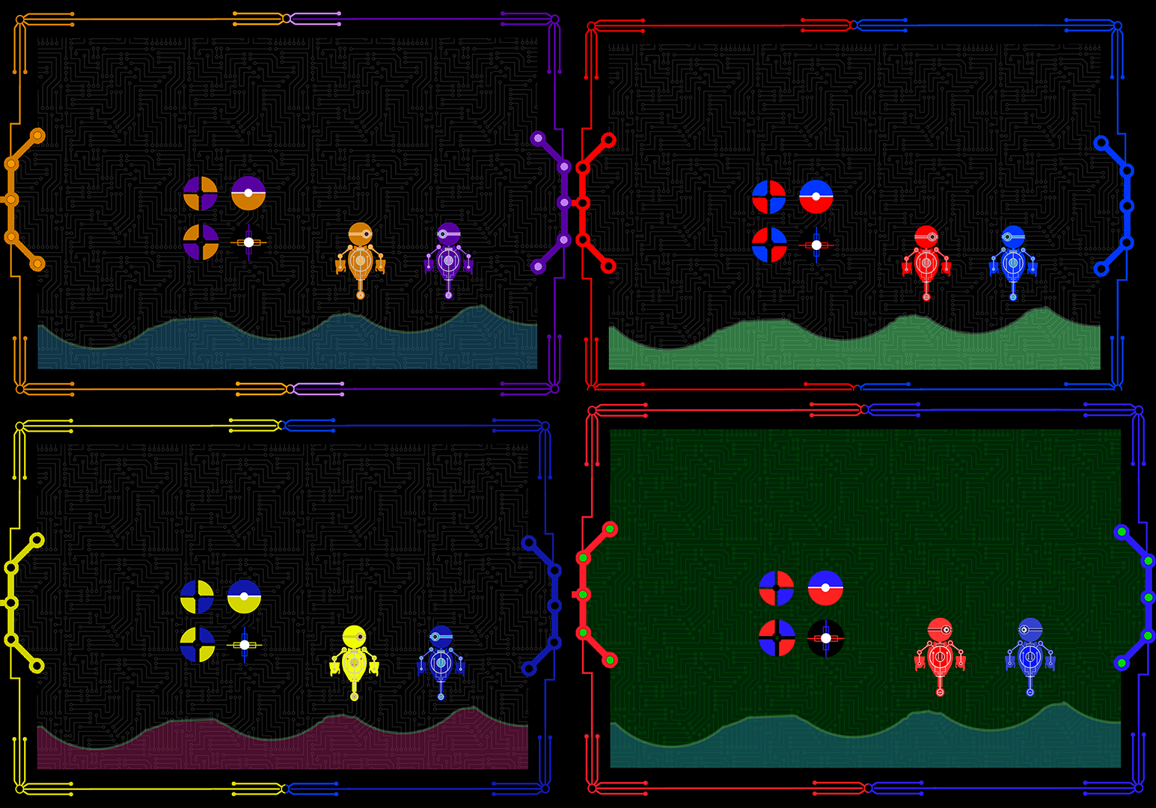
Colour Harmony's

Slide 14
Visual Feedback (Part 1)
Players found it difficult to determine when they had scored a goal.
No feeling of reward when a goal was scored.
Brainstormed ways to improve this part of the player experience.

Slide 15
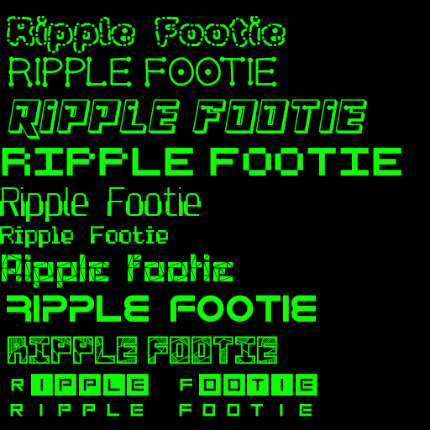
Visual Feedback (Part 2)

Slide 16
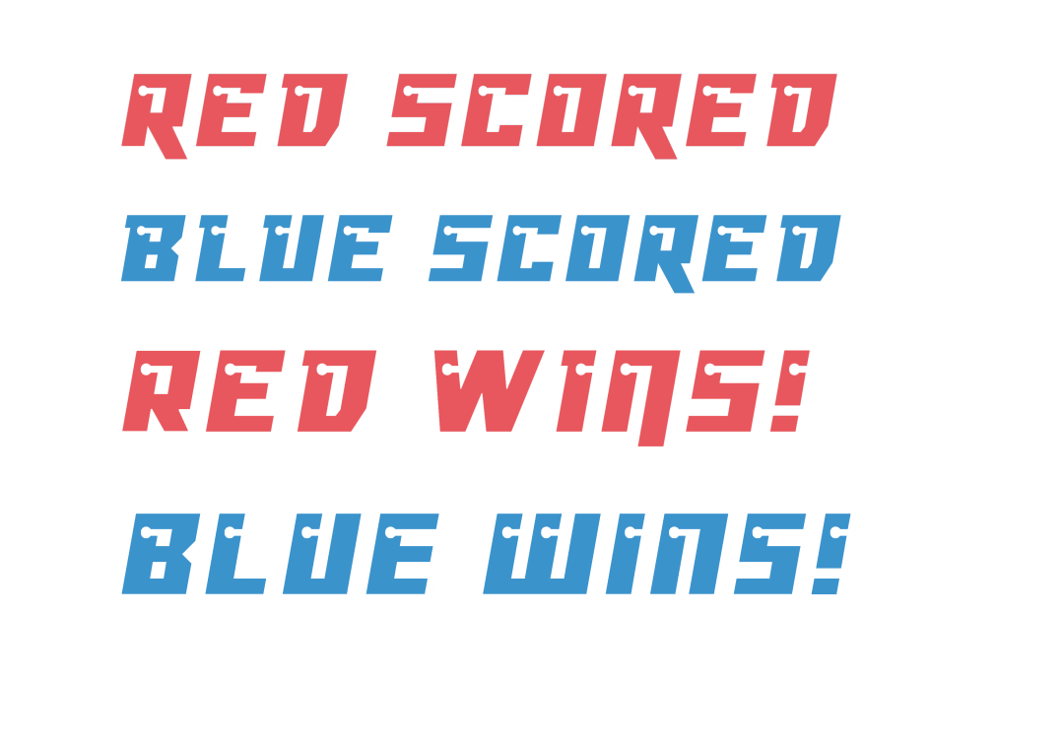
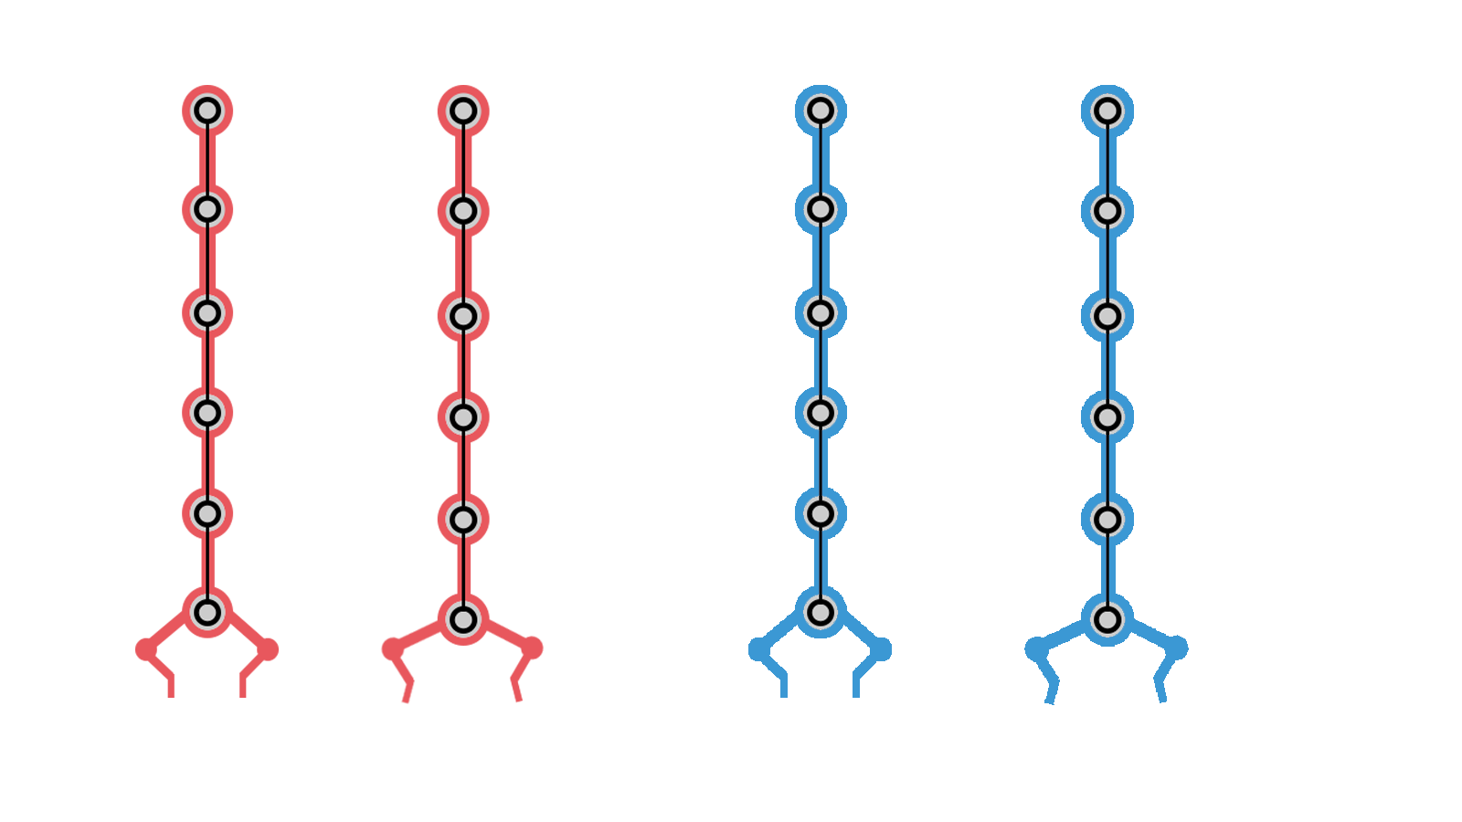
Visual Feedback (Part 3)
Popups.
Explosions.
Ball explodes.
Claw descending from the top to “drop” the ball.
The foreground is the UI.
Remove the UI bar.
Kick feedback
(yet to be implemented)

Slide 17
Current Iteration

Slide 18
Sprint Information
Hours Logged
Connor:
Henry:
Sam:
Heather:
Emails Sent
Connor:
Henry:
Sam:
Heather:

Slide 19
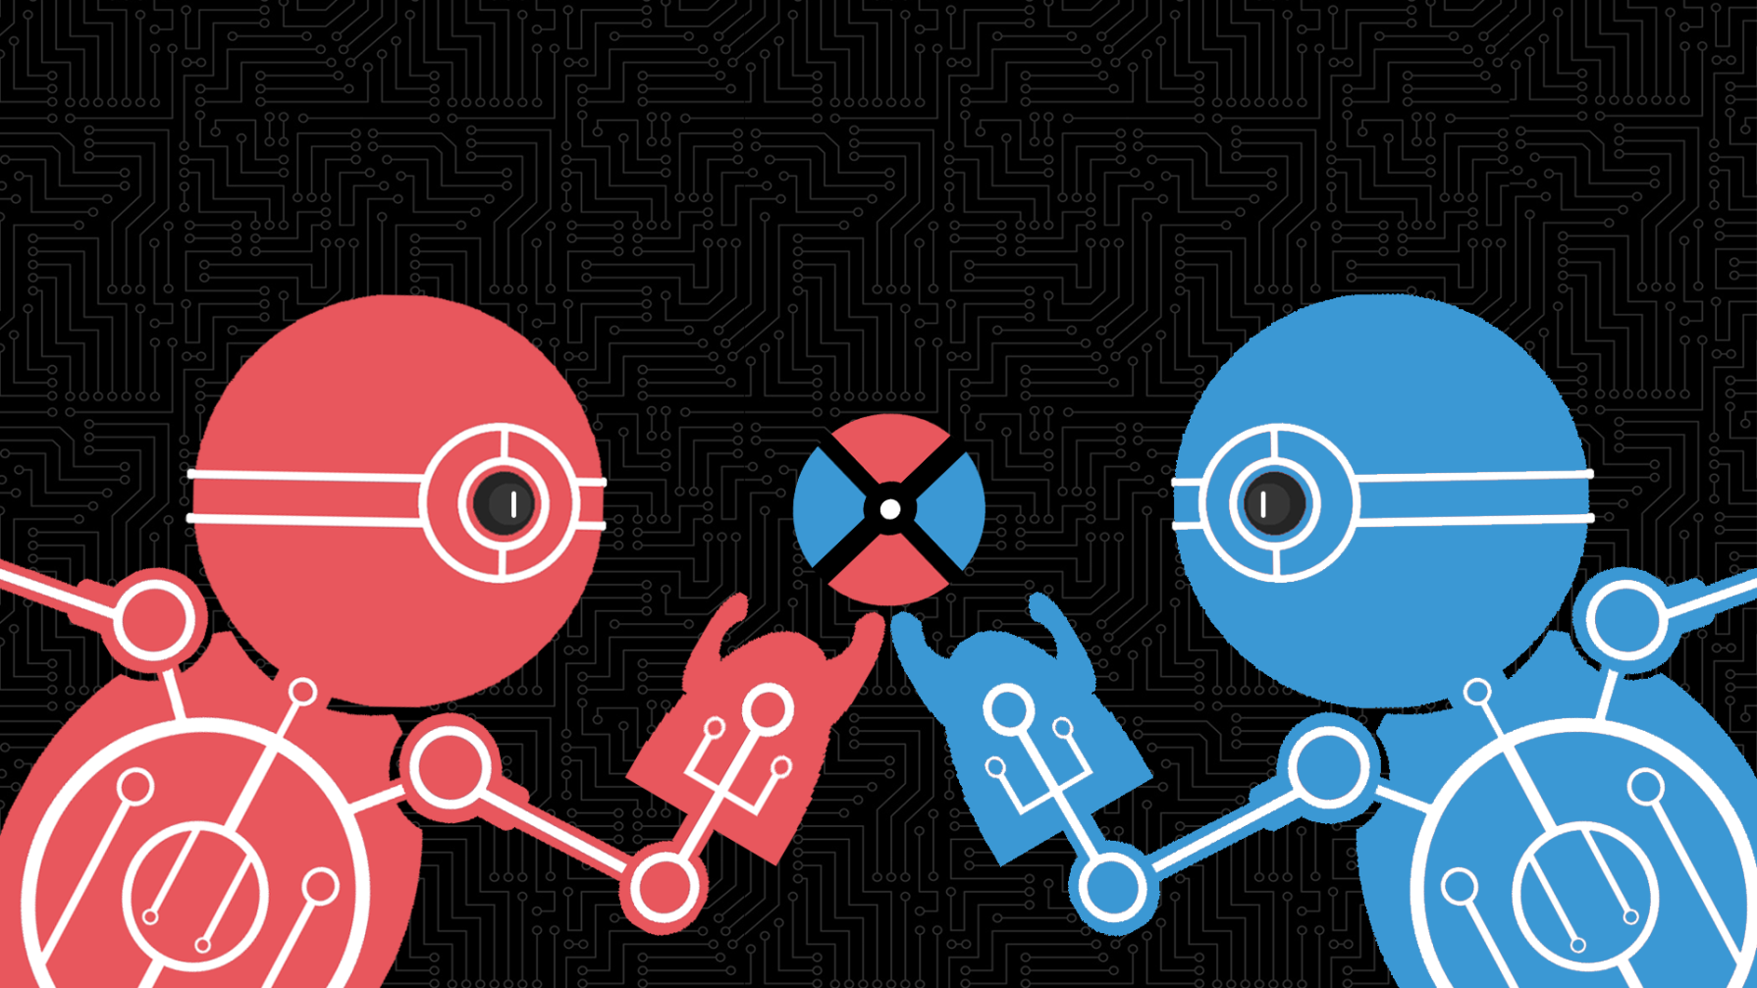
Questions?

